Slide 1

Finding regression bugs before QA
using Selenium
and Azure DevOps CI

Slide 2








We are exceptional at:
ADVISORY SERVICES
APPLICATION DEVELOPMENT
MOBILE SOLUTIONS
DATA & ANALYTICS
We’re an IT solutions company that solves tough technology challenges so you can get back to business better than usual.
INTERNET OF THINGS
APPLICATION MANAGEMENT
TESTING SERVICES
PLATFORM SERVICES

Slide 3






About Me
I have been developing software commercially for the last 15 year. In my free time I enjoy mixing live music for local Louisville bands, making movies, and developing video games.
https://github.com/cdwaddell
https://www.linkedin.com/in/cdwaddell
@cdanielwaddell

Slide 4



Can we
at least
automate
this?

Slide 5
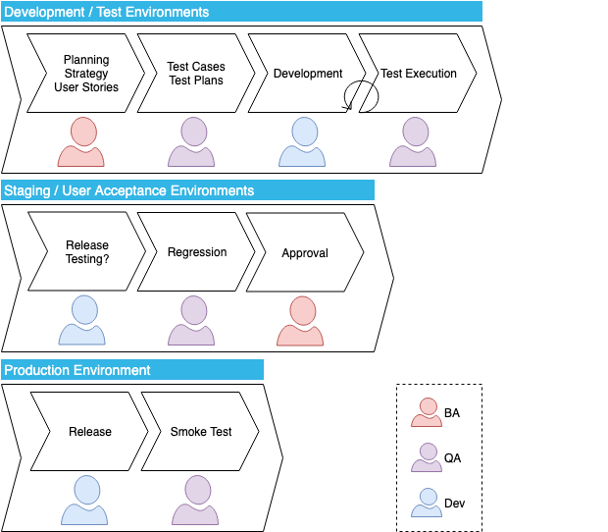





How can we maximize gain?

Slide 6
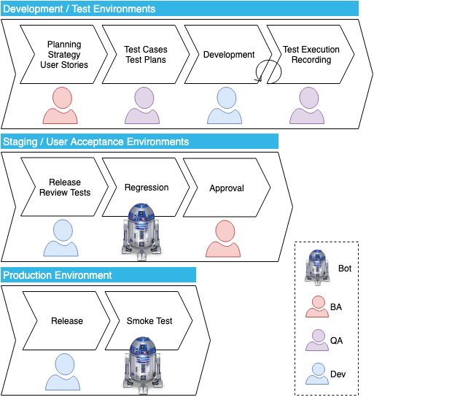
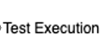
Let’s introduce automation

Slide 8
Let’s introduce automation

Slide 9

Codeless Test Automation
I know kids
Tooling has come a long way
Why should you reinvent the wheel?
CI/CD is your friend
Codeless tests scare me too!

Slide 10



Slide 11
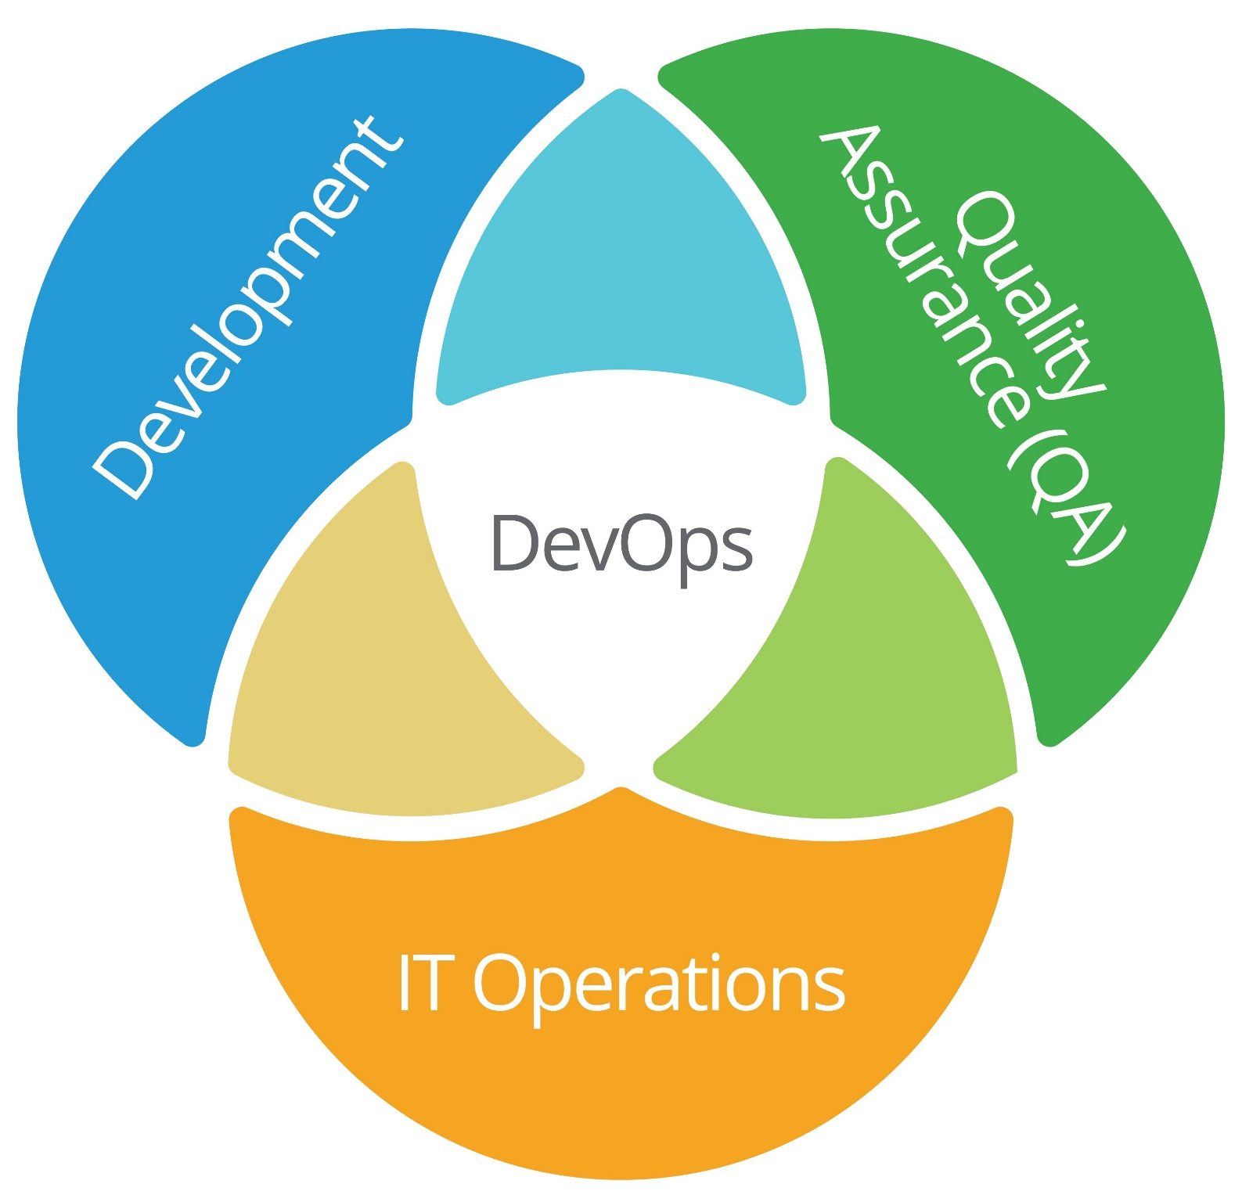

Slide 12
10 features every codeless test automation tool should offer
https://techbeacon.com/app-dev-testing/10-features-every-codeless-test-automation-tool-should-offer
Smart element locators
Conditional waiting
Control structures
Easy assertions
Modification without redo
Reusable steps
Cross-browser support
Reporting
Ability to insert code
Continuous integration

Slide 13



Tooling for Recording
Some options for codeless test automation
Selenium IDE
Katalon Recorder
Robot Framework

Slide 14


Slide 15









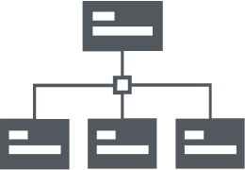




















Slide 16































Slide 17































Slide 18











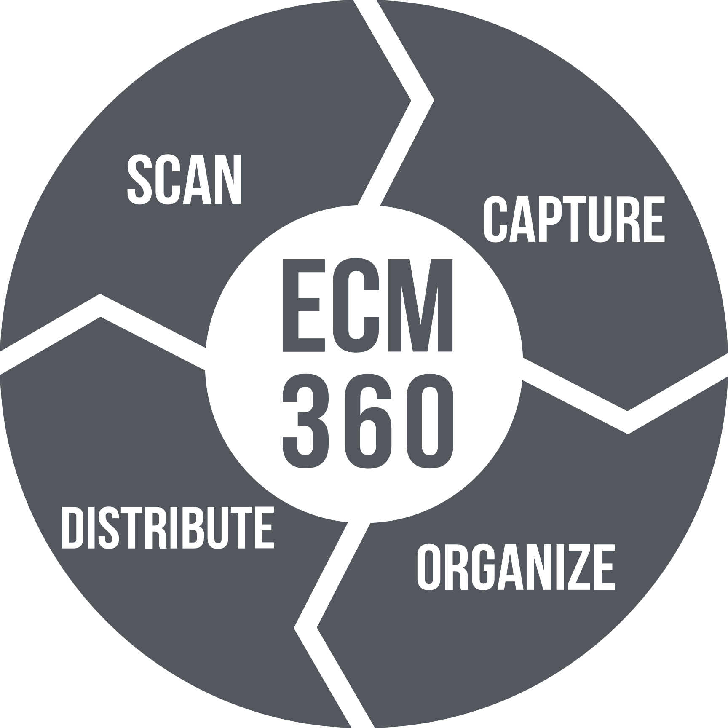
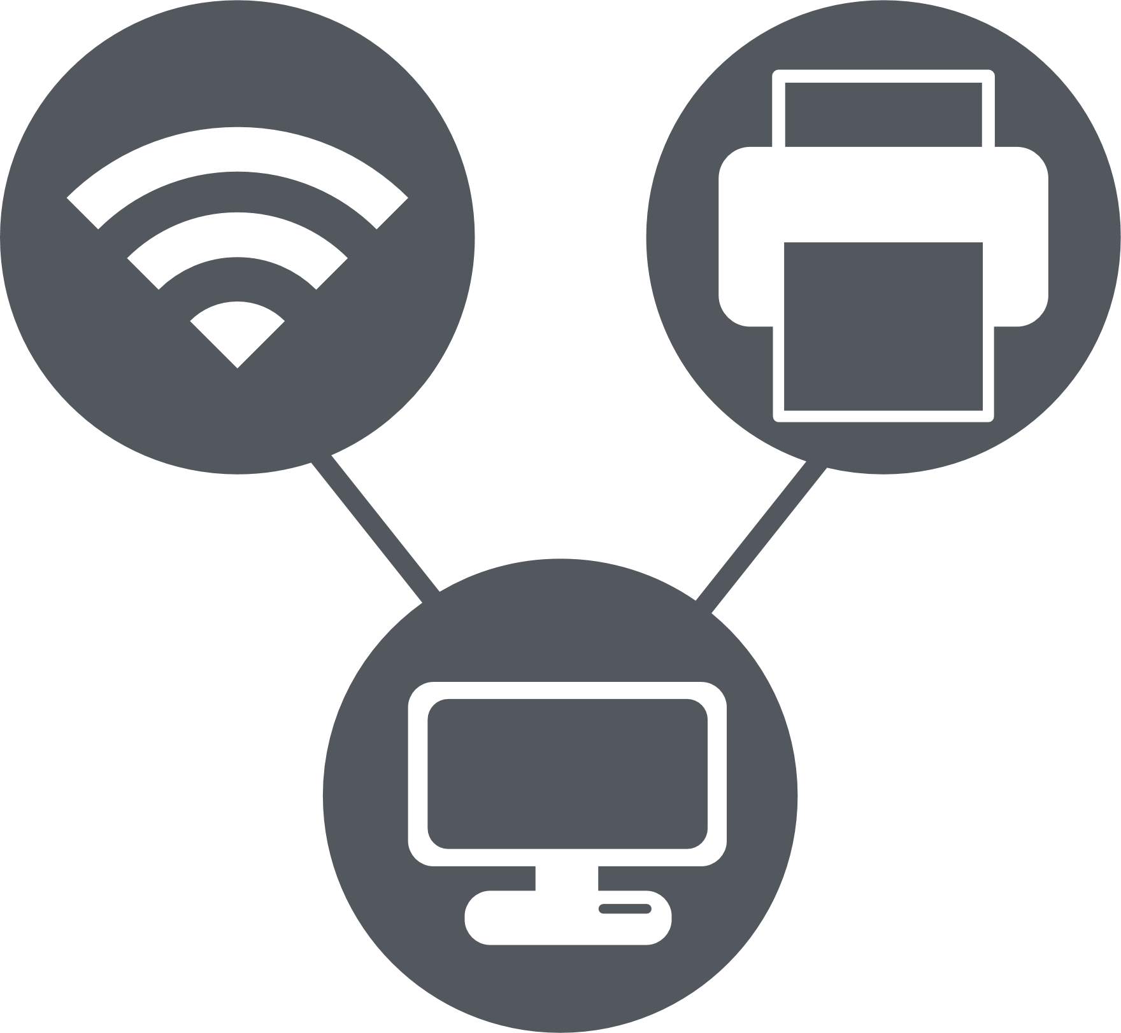

CIO
CMO
Developer
IT Manager
Content Manager
CIO
CMO
Developer
IT Manager
Content Manager
egrants
Enterprise
Content MGMT.
Managed Services
Technology Solutions

